Slide 1
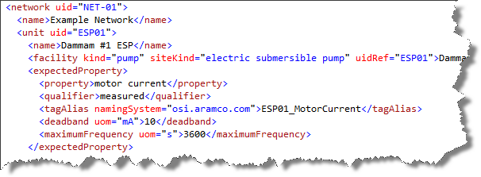
Product Flow Model
Product Flow Model
Product Flow Model

